Slide 1
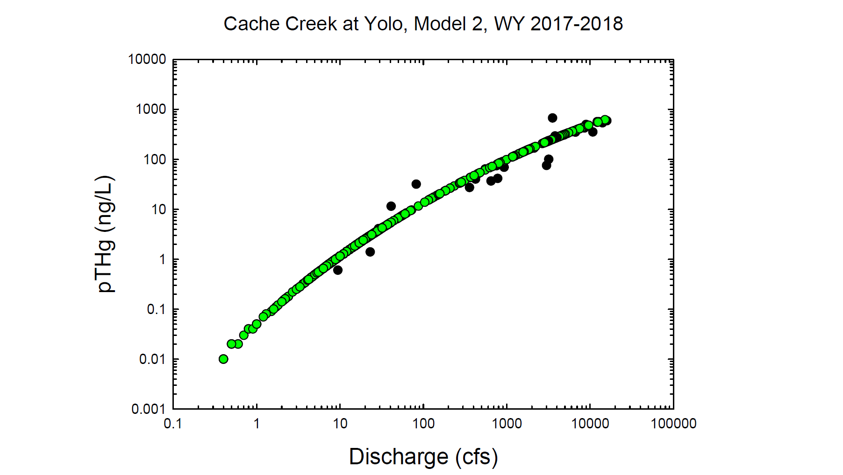
Black circles = Observed values
Green circles = Modeled values

Slide 2
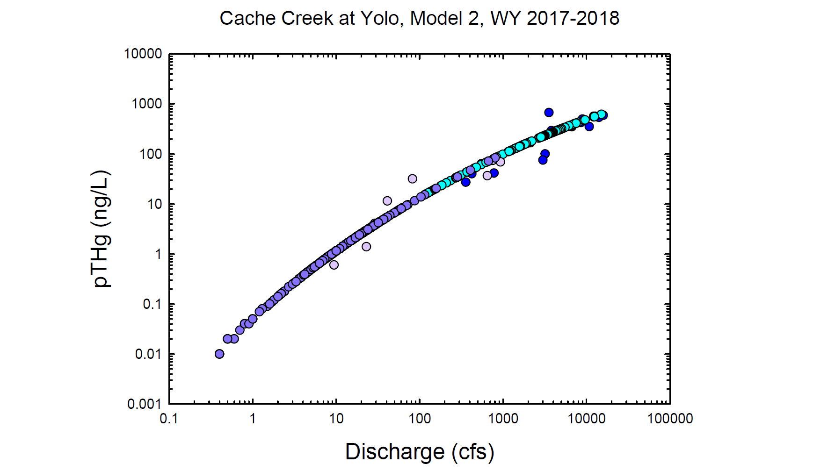
Dk. Blue = Observed wy2017
Lt. Purple = Observed wy2018
Lt. Blue = Modeled wy2017
Dk. Purple = Modeled wy2018

Slide 3
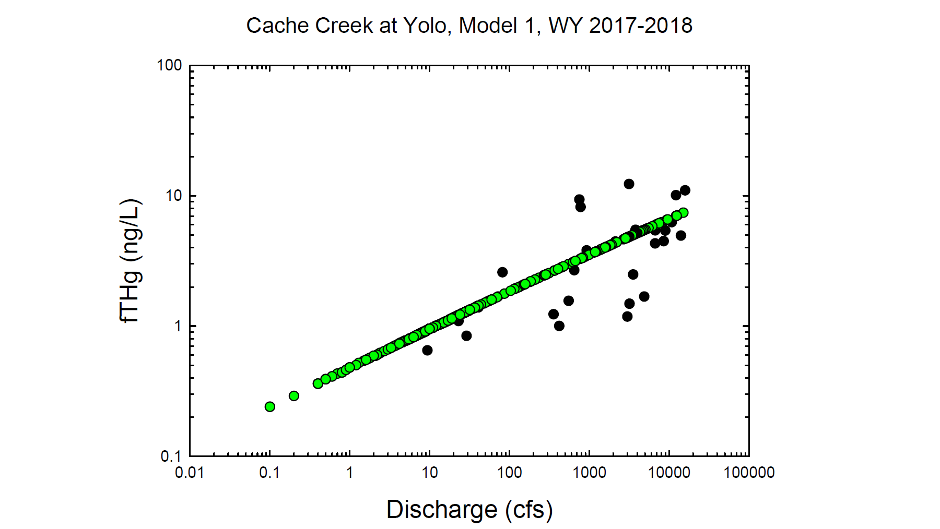
Black circles = Observed values
Green circles = Modeled values

Slide 4
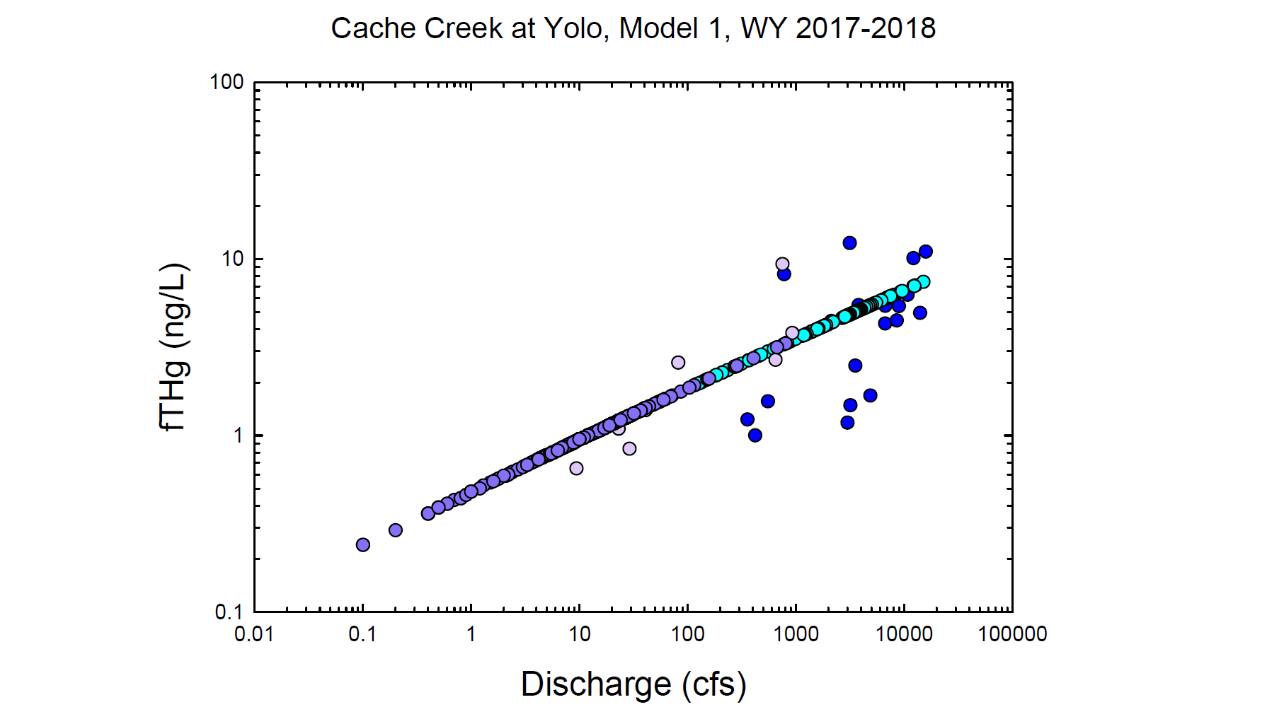
Dk. Blue = Observed wy2017
Lt. Purple = Observed wy2018
Lt. Blue = Modeled wy2017
Dk. Purple = Modeled wy2018

Slide 5
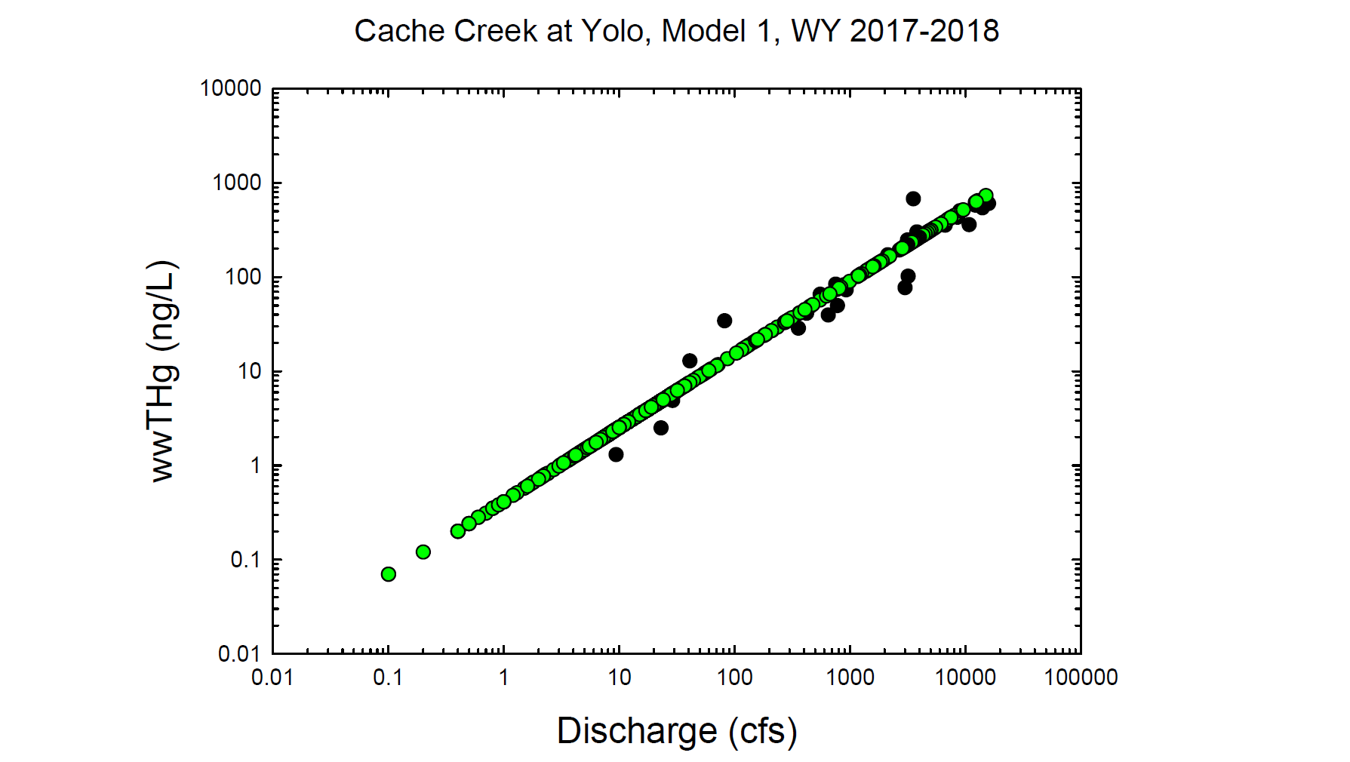
Black circles = Observed values
Green circles = Modeled values

Slide 6
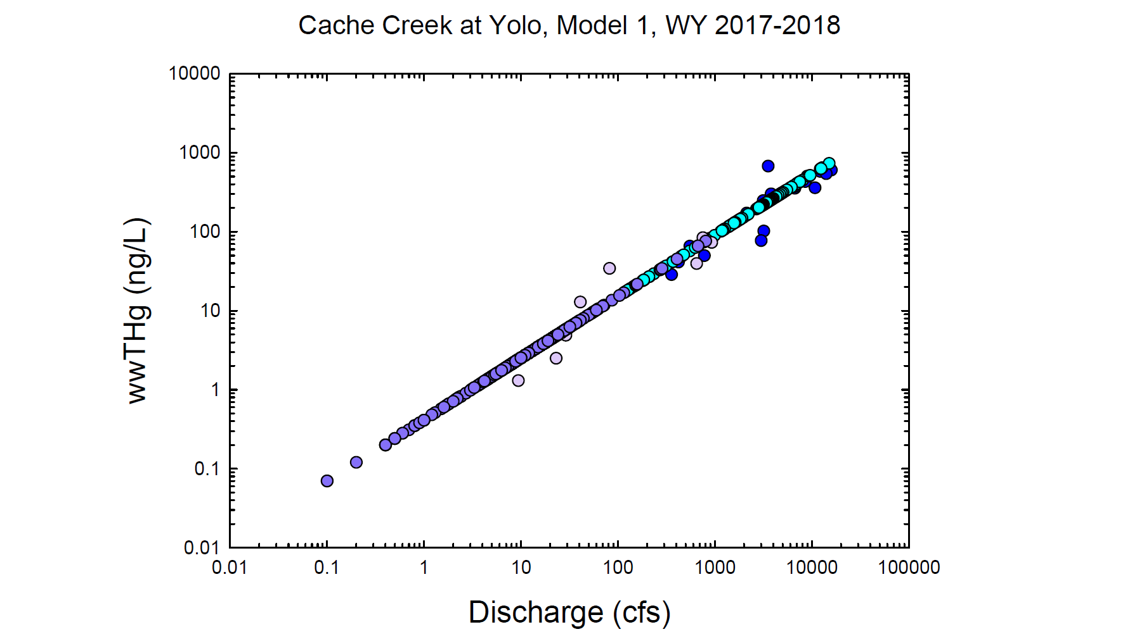
Dk. Blue = Observed wy2017
Lt. Purple = Observed wy2018
Lt. Blue = Modeled wy2017
Dk. Purple = Modeled wy2018

Slide 7
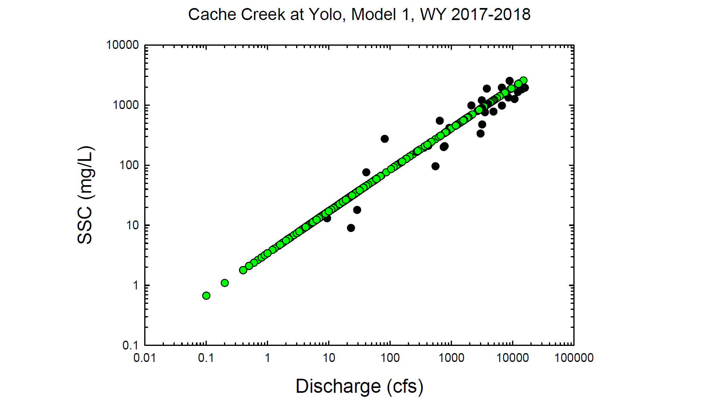
Black circles = Observed values
Green circles = Modeled values

Slide 8
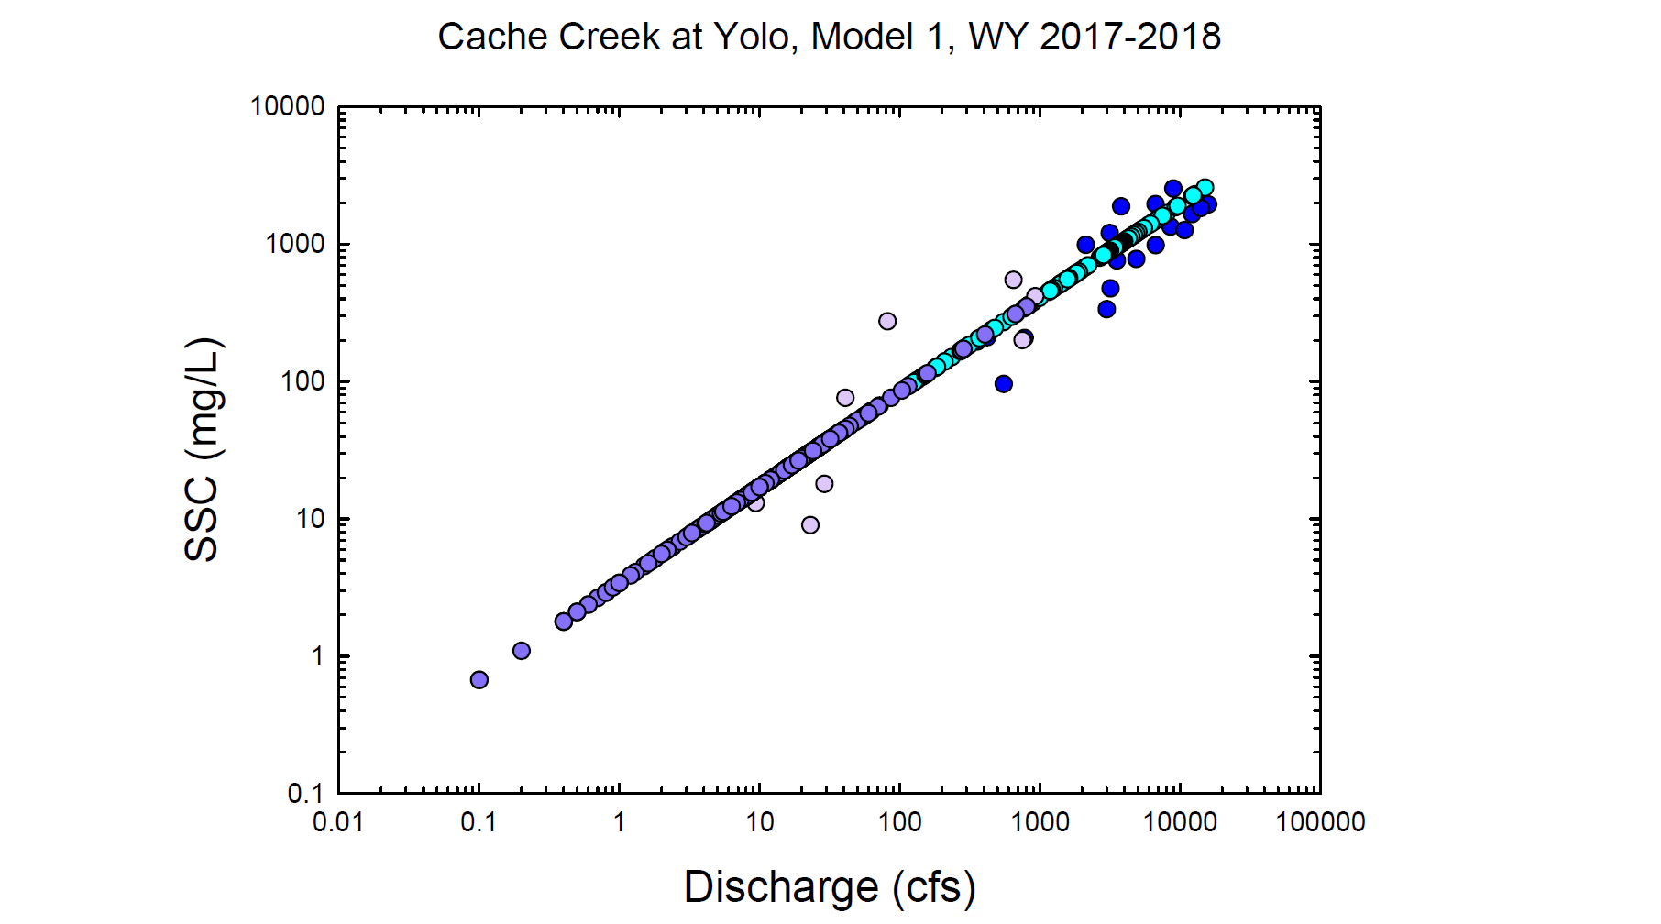
Dk. Blue = Observed wy2017
Lt. Purple = Observed wy2018
Lt. Blue = Modeled wy2017
Dk. Purple = Modeled wy2018

